Slide 1
Health-Care Chat Bot
Aryan Veturekar
Danish Shaikh
Himanshu Singh
Guide – Prof. Varsha Wangikar

Slide 2



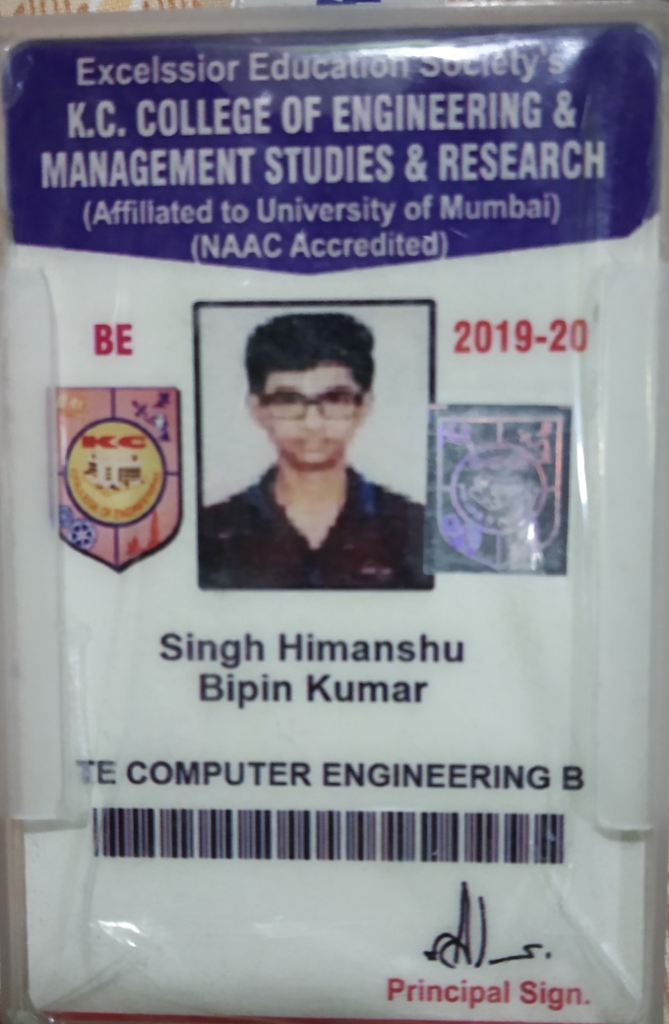
ID Cards

Slide 3
Index
Problem Statement
Process Model
Implementation Technology
Result
Advantages and Limitations
Conclusion and Future Scope
References

Slide 4
Problem statement
Through chat bots one can communicate with text or voice interface and get reply through artificial intelligence. Typically, a chat bot will communicate with a real person. Chat bots are used in applications such as ecommerce customer service, call centers and Internet gaming. Chat bots are programs built to automatically engage with received messages.
Chat bots can be programmed to respond the same way each time, to respond differently to messages containing certain keywords and even to use machine learning to adapt their responses to fit the situation. A developing number of hospitals, nursing homes, and even private centers, presently utilize online Chat bots for human services on their sites. These bots connect with potential patients visiting the site, helping them discover specialists, booking their appointments, and getting them access to the correct treatment.
An ML model has to be created wherein we could give any text input and on the basis of training data it must analyze the symptoms. A Supervised Logistic Regression machine learning algorithm can be implemented to train the model with data sets containing various diseases CSV files. The goal is to compare outputs of various models and suggest the best model that can be used for symptoms in real-world inputs. Data set contains CSV file having all diseases compiled together.

Slide 5
Problem Statement
The logistic regression algorithm in ML allows us to process the data efficiently. The goal here is to model the underlying structure or distribution of the data in order to learn more from the training set.
In any case, the utilization of artificial intelligence in an industry where individuals’ lives could be in question, still starts misgivings in individuals. It brings up issues about whether the task mentioned above ought to be assigned to human staff. This healthcare chat bot system will help hospitals to provide healthcare support online 24 x 7, it answers deep as well as general questions. It also helps to generate leads and automatically delivers the information of leads to sales. By asking the questions in series it helps patients by guiding what exactly he/she is looking for.

Slide 6
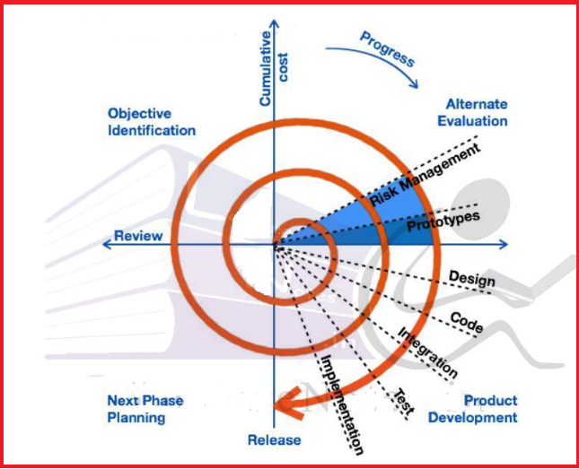
Process Model

Slide 7
Implementation Technology
Hardware Requirement:
RAM: 512 MB
ROM: 1 GB
Monitor with minimum screen resolution of 1024x768.
Software Requirement:
Windows XP & above.
MacOS 8.0 & above.
Browsers:
Google Chrome, Mozilla Firefox, IE(Internet Explorer),
Microsoft Edge

Slide 8
Dataset Details
The data set is collected from Kaggle Machine Learning Repository. It is a public set of diseases collected for doctoral research. It has three datasets composed by numbers of real disease extracted from all the doctors that are among the top doctors in their feild. Thus, it will collect those diseases and doctors from a dataset according to the symptoms categories such as fatigue, sneezing, cold and others.

Slide 9
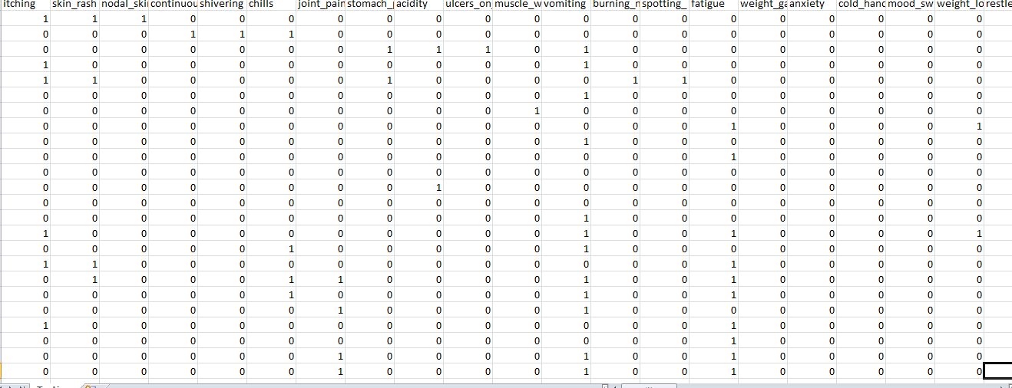
Testing Dataset

Slide 10
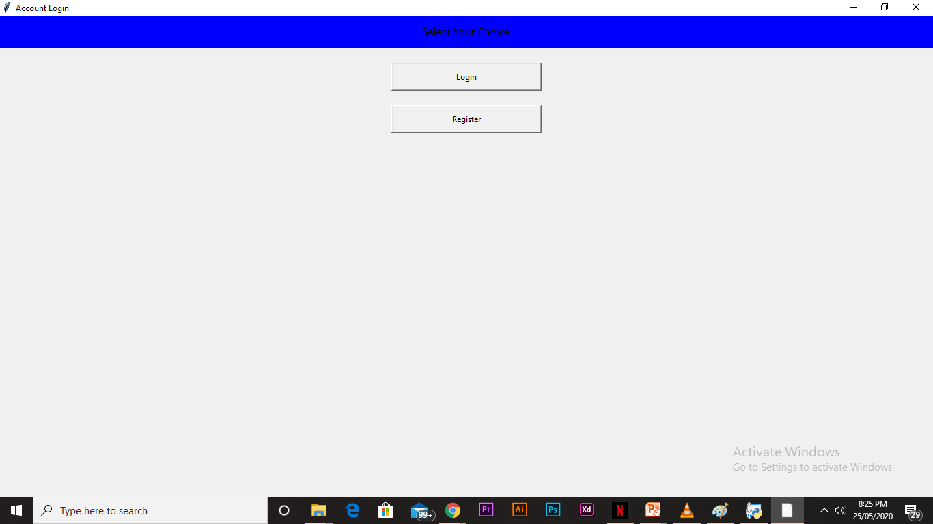
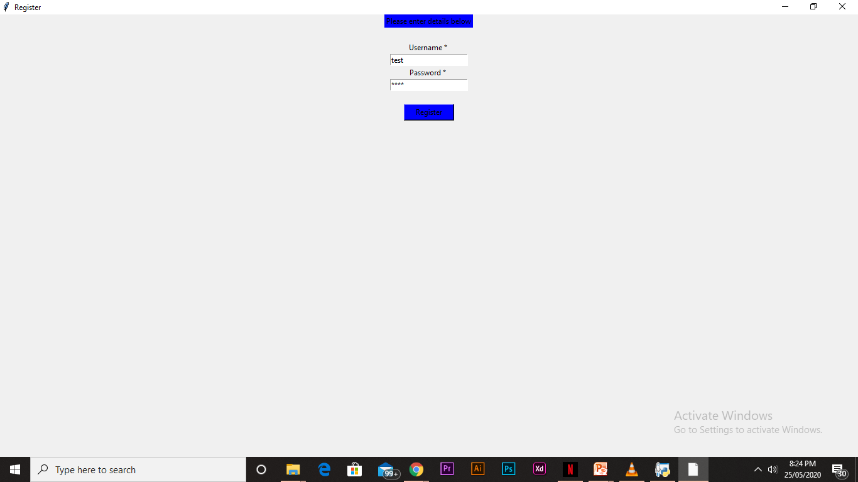
Result

Slide 11
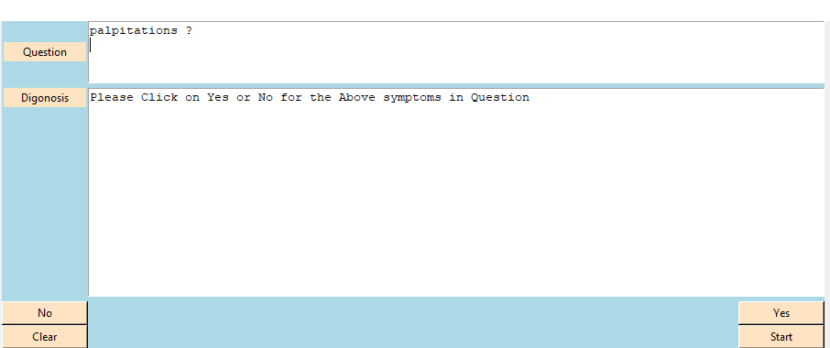

Result

Slide 12
Analysis of Result
We can conclude that this system giving the accurate result. As we are using large dataset which will ensures the better performance.
Thus we build up a system which is useful for people or hospitals to help the users to freely ask medical doubts and concerns over text. System will get output for the disease. User can get related answer displayed on software and refer it for analysis

Slide 13
Advantages
1. Accessible anytime:
I’m sure most of you are always kept on hold while operators connect you to a customer care executive. On an average people spend around 7 minutes until they are assigned to a person. Gone are the frustrating days of waiting in a queue for the next available operative. They are replacing live chat and other forms of slower contact methods such as emails and phone calls. Since chat bots are basically virtual robots they never get tired and continue to obey your command. They will continue to operate every day throughout the year without requiring to take a break
2. Handling Capacity:
Unlike humans who can only communicate with one human at a time, chat bots can simultaneously have conversations with thousands of people. No matter what time of the day it is or how many people are contacting you, every single one of them will be answered immediately

Slide 14
Advantages
1. Omni-capable
The chat bot converses seamlessly across multiple digital channels and retains data and context for a seamless experience. In best cases, even passing that information to a live agent if needed.
2. Free to Explore
The chat bot can reach, consume, and process vast amounts of data– both structured and unstructured–to surface insights from any source - to gather relevant data to solve customer issues quickly.
3. Autonomous Reasoning
The chat bot can perform complex reasoning without human intervention. For example, a great Service chatbot should be able to infer solutions based on relevant case histories.
4. Pre-Trained
The chat bot is pre-trained to understand brand-specific or industry-specific knowledge and terms. Even better, it’s pre-configured to resolve common customer requests of a particular industry.
5. Register/Log-in
To access this chat bot and individual needs to register and then use the registration ID to log in to access the features.
6. User Interface
A user friendly interface which is engaging and easy to access.

Slide 15
Disadvantages
Complex Interface – Chatbots are often seen to be complicated and require a lot of time to understand user’s requirement. It is also the poor processing which is not able to filter results in time that can annoy people.
Inability to Understand – Due to fixed programs, chatbots can be stuck if an unsaved query is presented in front of them. This can lead to customer dissatisfaction and result in loss. It is also the multiple messaging that can be taxing for users and deteriorate the overall experience on the website.
Time-Consuming – Chatbots are installed with the motive to speed-up the response and improve customer interaction. However, due to limited data-availability and time required for self-updating, this process appears more time-taking and expensive. Therefore, in place of attending several customers at a time, chatbots appear confused about how to communicate with people.

Slide 16
Disadvantages
Zero decision-making – Chat bots are known for being infamous because of their inability to make decisions. A similar situation has landed big companies like Microsoft etc. in trouble when their chat bot went on making a racist rant. Therefore, it is critical to ensure proper programing of your chat bot to prevent any such incident which can hamper your brand.
Poor Memory – Chat bots are not able to memorize the past conversation which forces the user to type the same thing again & again. This can be cumbersome for the customer and annoy them because of the effort required. Thus, it is important to be careful while designing chat bots and make sure that the program is able to comprehend user queries and respond accordingly.

Slide 17
Conclusion & Future Scope
Chat bots are a thing of the future which is yet to uncover its potential but with its rising popularity and craze among companies, they are bound to stay here for long. Machine learning has changed the way companies were communicating with their customers. With new platforms to build various types of chat bots being introduced, it is of great excitement to witness the growth of a new domain in technology while surpassing the previous threshold.

Slide 18
References
https://en.wikipedia.org/wiki/Chatbot https://en.wikipedia.org/wiki/Disease
https://data-flair.training/blogs/python-chatbot-project/
https://www.youtube.com/playlist?list=PLQVvvaa0QuDdc2k5dwtDTyT9aCja0on8j

Slide 19
